Slide 1
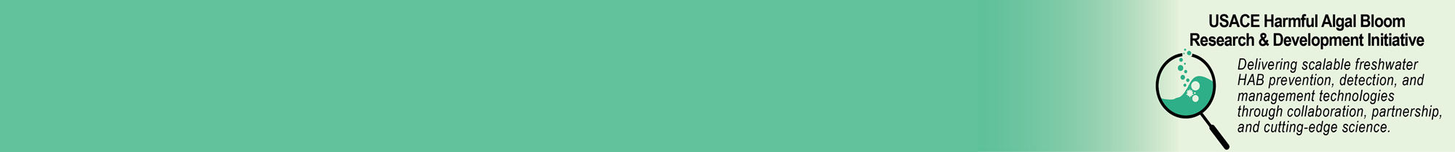

Expanding the USACE Toolkit for HABs
Water Quality and Contaminant Modeling, USACE-ERDC
Drs. Jodi L. Ryder, Todd E. Steissberg, Barry W. Bunch
Objective: Create tools to prevent, mitigate, and monitor HABs at USACE projects
Deterministic = Parameterize constituent relationships using empirical data to build system of equations to that describe system behavior.
CE-QUAL-W2
CE-QUAL-ICM
Numerical and analytical
Works best when constituent relationships are well known and static and homogeneous.
Hydro-Meteorology
Model
Hybrid, Blended, Physics Informed = Use deterministic modeling for some constituents and probabilistic for others.
Works best when some aspects of system are well known and homogeneous and others are uncertain, heterogeneous, or dynamic.
BioGeoChemical
Processes
Hydraulics and Operations
Operational
HAB
Management
Probabilistic = Parameterize constituent relationships using statistics and build system of equations to describe
CE-QUAL-W2
CE-QUAL-ICM
Countless others
Probabilistic = Use statistical parameterization and relationships to build system of equations that describe system behavior.
BMA
Random Forest
Data Driven
Most useful when constituent relationships have uncertainty but there is lots of field data to fully bracket the uncertainty.
Jodi.L.Ryder@usace.army.mil, May 2024

Slide 2
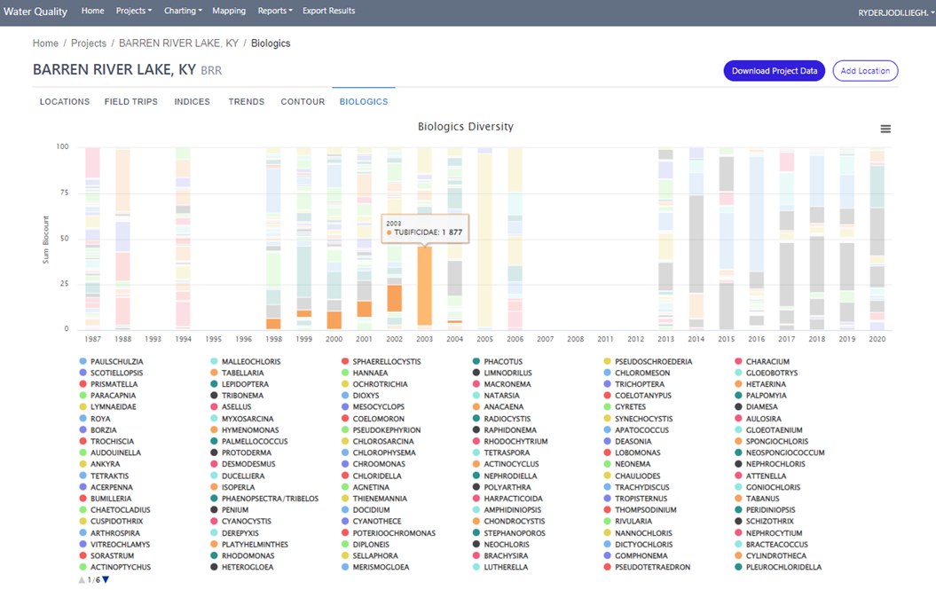
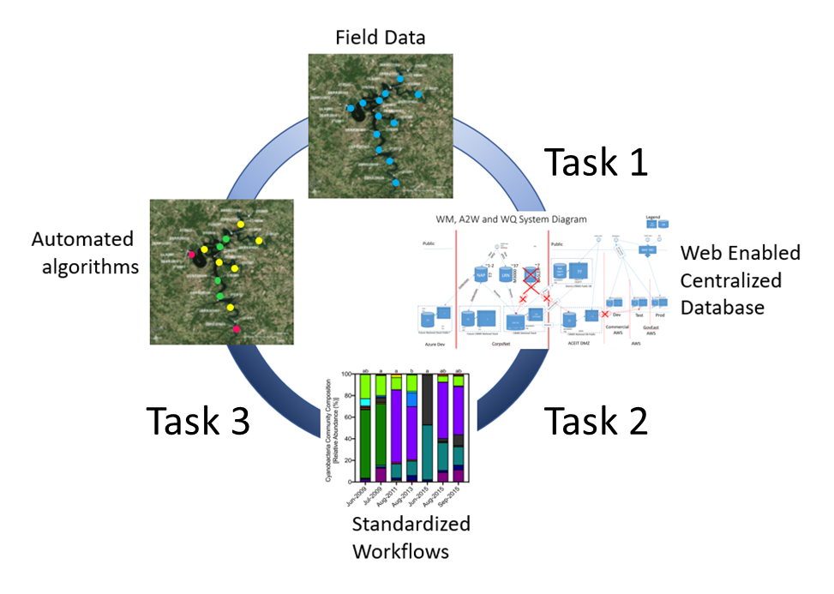
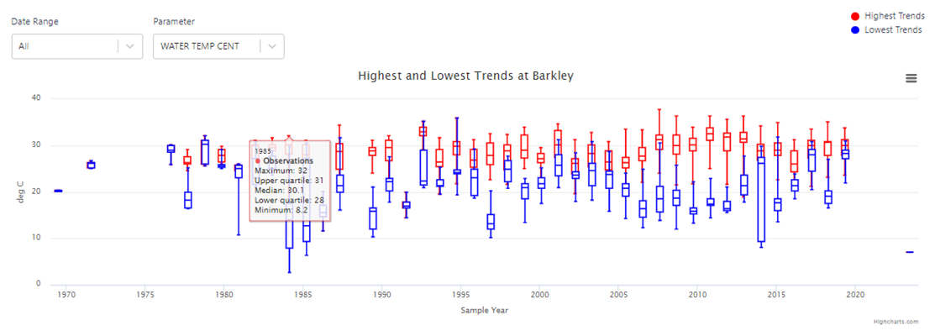
Evaluation of Historic Water Quality Information and Cyanobacteria Harmful Algae Bloom Events Jodi L. Ryder (jodi.l.ryder@usace.army.mil, 601-631-1852), Jeremy Kellett (NAE)
Operationalizing Water Quality Data
Overall Objective
Identify high value water quality and phytoplankton parameters and maximize the information contained in diverse data types
Functionalities created for EWQDB
Data inventory
Inventory maps
Date heatmaps
Multi-factoral filtering
Physical data capabilities
Temperature profile timeseries
Chemical data capabilities
Event and annual statistical charts
Carlson Indicies
Vollenweider Indicies
Biologic data capabilities
Taxonomic diversity plots
Shannon diversity index
Continuing Development
HAB Vulnerability Index (HVI)
Taxonomic diversity plots
Technical Approach
Create algorithms within a unified USACE-wide Enterprise Water Quality Database (EWQDB) for database extraction, statistical analysis, and post-processing to generate a HAB Vulnerability Index (HVI)
Statistical charting
Jodi.L.Ryder@usace.army.mil, May 2024

Slide 3
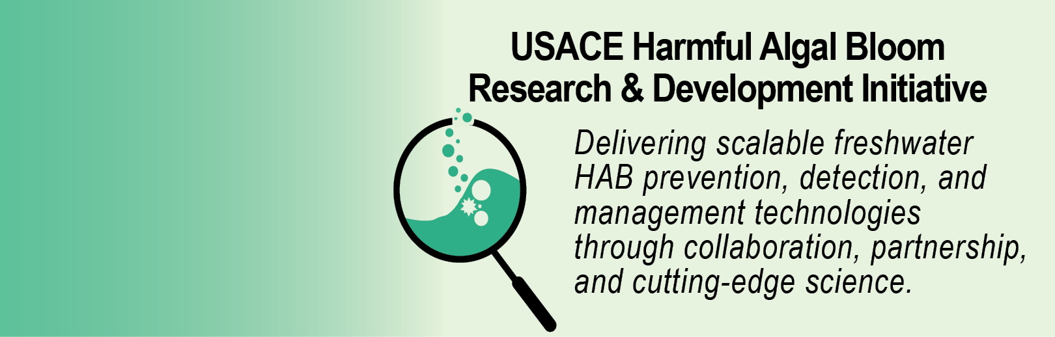


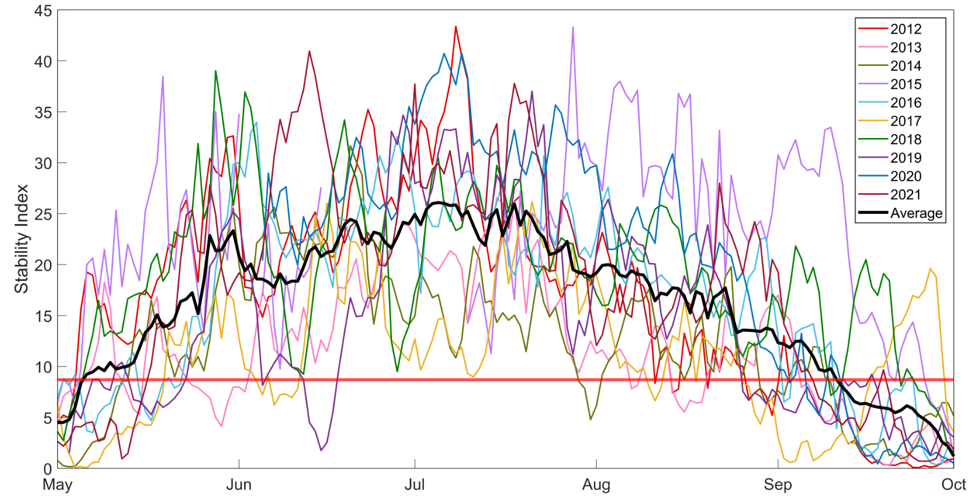
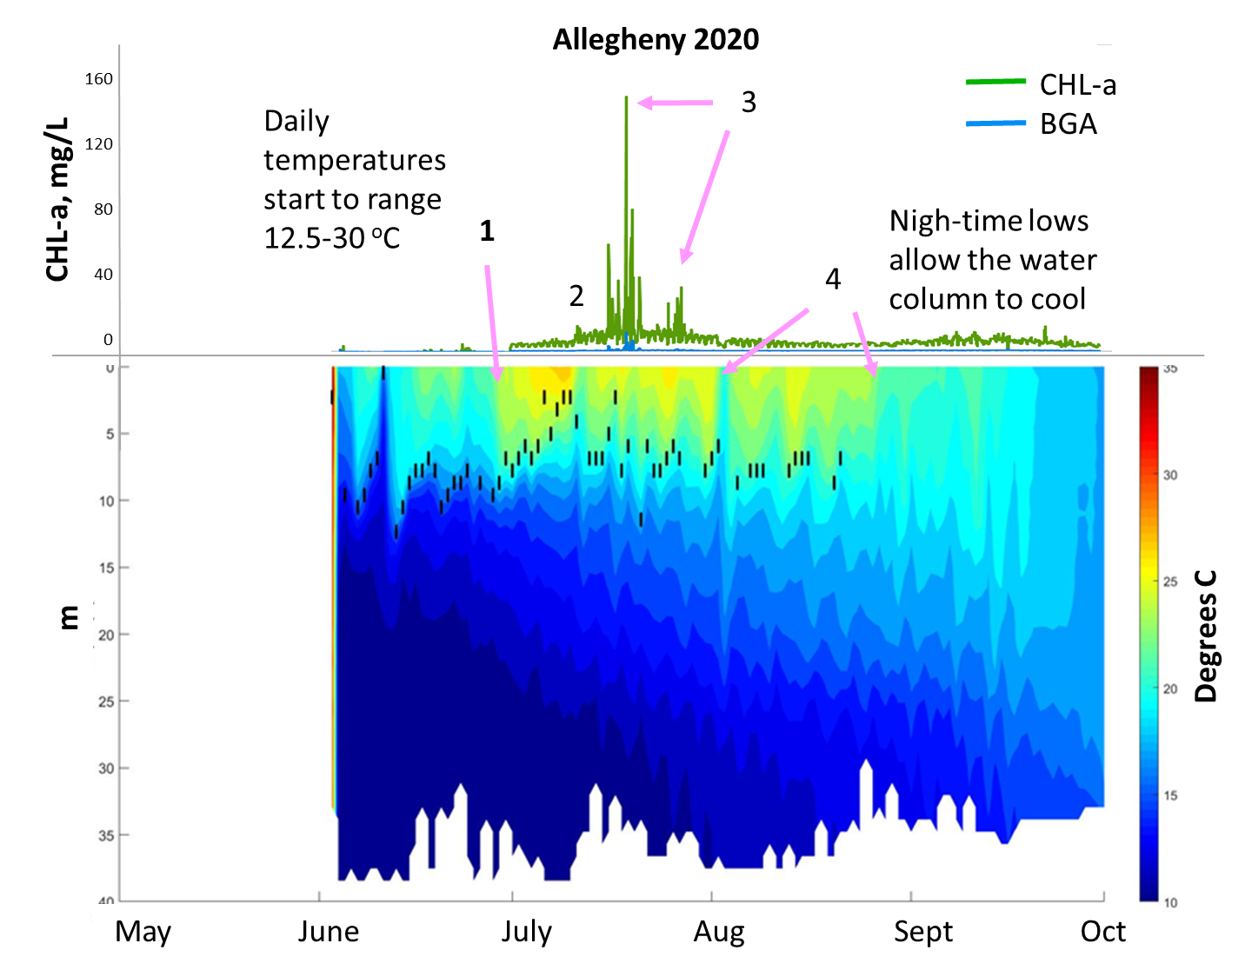
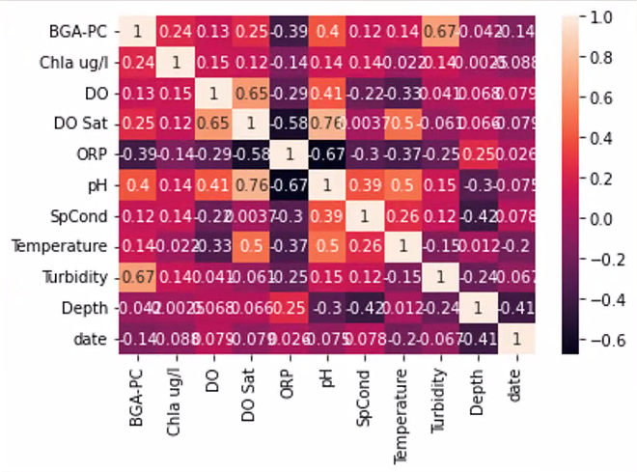
Developing Deterministic Parameters that Enhance Monitoring Activities and Enable Probabilistic Modeling
High frequency monitoring
Water temperature profiles, chlorophyll-a, phycocyanin, DO, water depth
Stability Index Vulnerability Analysis (SIVA)
Utilizes the Schmidt Staility Index formulation of Sahoo (2016) to create a high frequency physically informed parameter for additional analysis.
Forecasting HABs with Advanced Statistical Models
Annual stratification patterns and
climate effects on reservoirs
Summers and Ryder, 2023
Operational
HAB
Management
Month | % Lakes with SI Increasing
May | 20%
June | 80%
July | 100%
Aug | 80%
Sept | 80%
LSTM, GRU, etc.
Summers and Ryder, 2024
May, 25, 2023
POC: Jodi.L.Ryder@usace.army.mil
Jodi.L.Ryder@usace.army.mil, May 2024

Slide 4
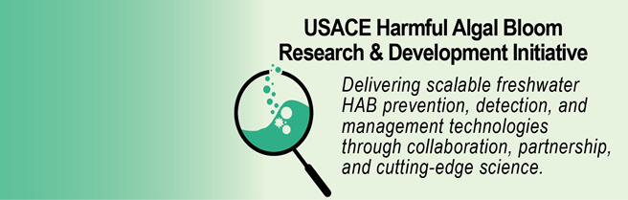
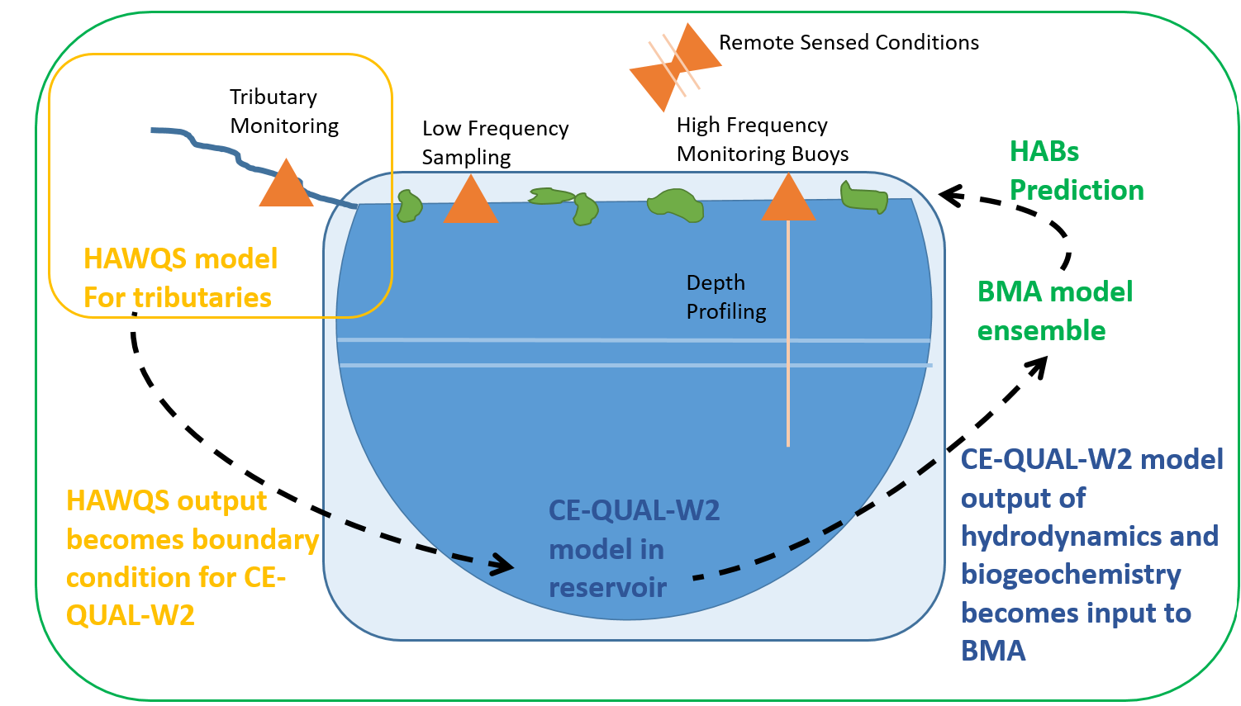
Improved HAB Prediction Using Hybrid Models
Hybrid Modeling System Under Development
HAWQS improves boundary information.
CE-QUAL-W2 enables a spatial component grounded in validated nutrient-water quality processes.
BMA machine learning adds a capability to integrate all available empirical data sources such as satellite imagery, water samples, and weather data
Operational
HAB
Management
May, 25, 2023
POC: Jodi.L.Ryder@usace.army.mil
Jodi.L.Ryder@usace.army.mil, May 2024

